Slide 1
Credit Card Usage Segmentation

Slide 2
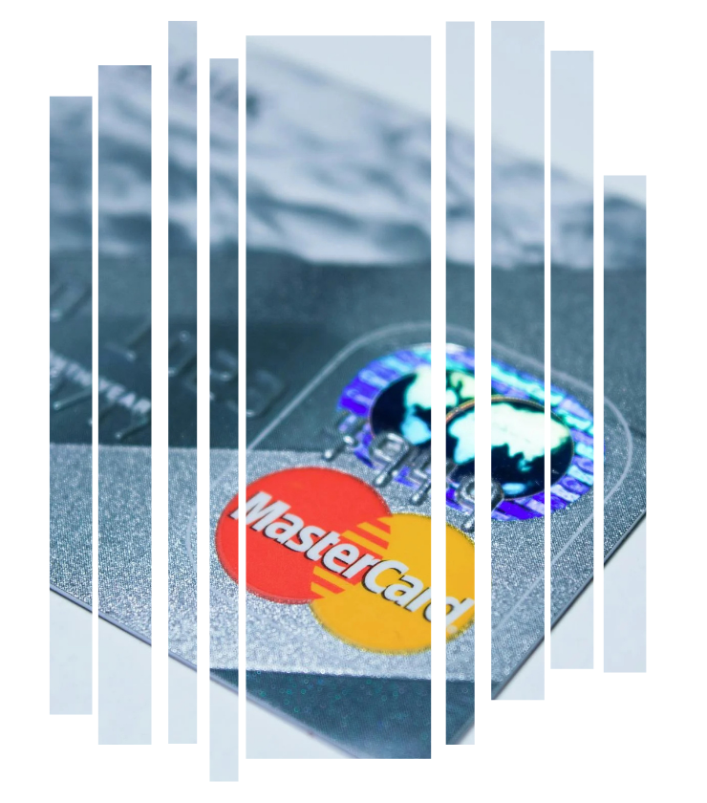
Business Problem Overview
Create an unsupervised learning model to categorized credit card customer by their spending and payment pattern.
Identify distinct customer segments
To improve customer relationship management
Develop actionable insights

Slide 3
Data Overview
1564
4494
1733
11.5
Balance
Credit Limit
Payment
Tenure
1003
411
979
592
Purchase
Installment purchase
Cash Advance
Oneoff purchase
The above figures shows the average values of the main features of the data set

Slide 4
Feature Scaling
Log scaler & MinMax Scaler
Log transformation reduces skewness and compresses extreme values, but it doesn’t standardize the data to a particular range.
Applying Min-Max scaling afterward can bring all features into a common range (typically 0 to 1), making them easier to interpret and ensuring they contribute equally to distance calculations in algorithms like K-Means.

Slide 5
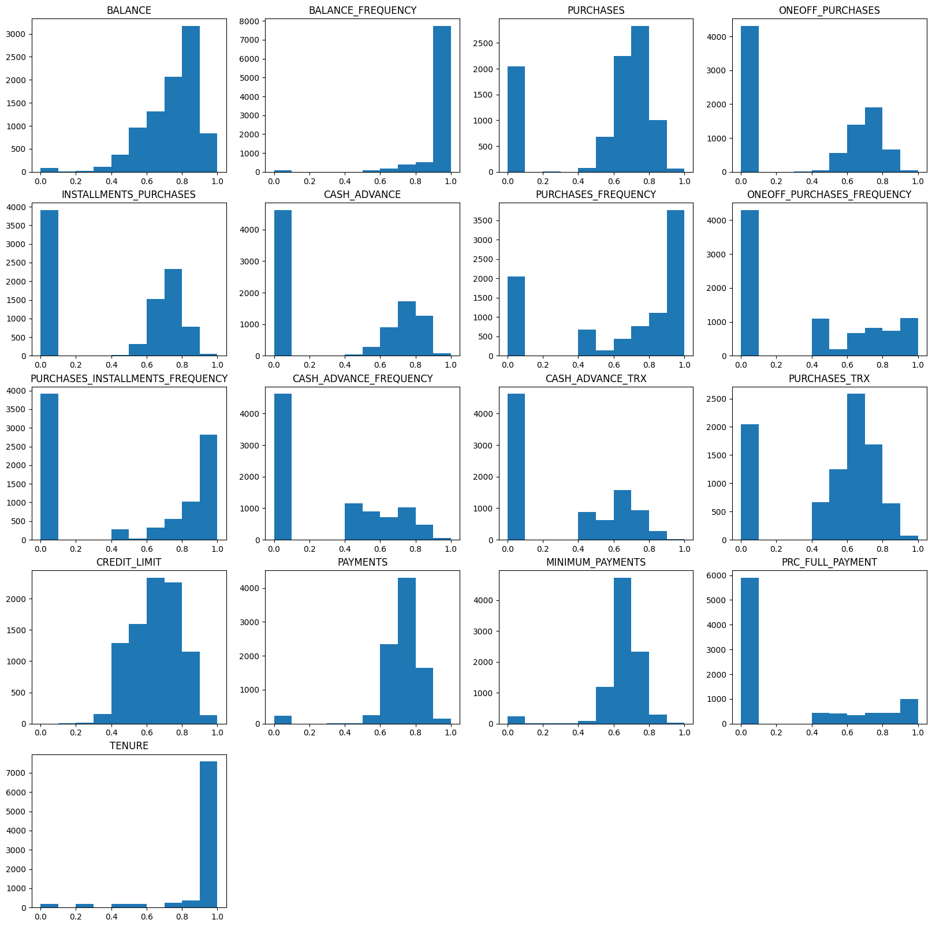
Exploratory Data Analysis (EDA)
Most customers have credit limits concentrated around the mid to high range, suggesting that they are most likely offered moderate credit levels, likely based on their spending behaviors
Payment distribution is skewed toward the higher end, with most customers making payments frequently. This indicates responsible repayment behavior among the majority , which could imply lower risk of default in payment.

Slide 6
This indicates a regular engagement but balance is generally skewed towards the lower end, suggesting limited spending or lower outstanding balance
Overall purchase values are high, but one-off purchase are relatively low, suggesting a preference to smaller transaction or installments.
There’s a notable segment with moderate to high values in users using installment purchases and rarely use the cash advance feature. This indicates cash advance are the least utilized feature.

Slide 7
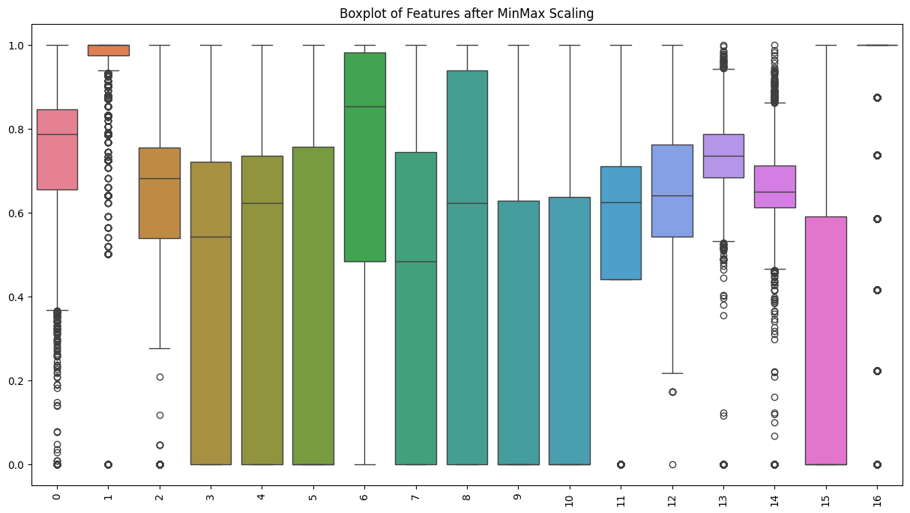
Variability Across Features
Features like BALANCE, CREDIT_LIMIT, and PURCHASE have wider distribution, indicating a broader range of values among customers. This suggests diverse spending and credit usage behaviors.
Outliers
Features like BALANCE_FREQUENCY, MINIMUM_PAYMENT, and PAYMENT display a significant number of outliers, This indicate that some customers have unusually high or low values. These bahaviors can signify risk or unique sepending habits.
Summary
This analysis reveals wide range of customer behaviors in spending, payment, and credit utilization, with notable outliers and consistent trends in certain features. These patterns support the segmentation efforts. The insight gathered can guide targeted marketing, customized offers, and proactive risk management strategies for each segment
Behavioral insights
The variability of the frequency features highlights differing usage habits. Higher PURCHASES or CASH ADVANCE FREQUENCY may indicate reliance on credit for frequent transactions or short-term liquidity needs.

Slide 8
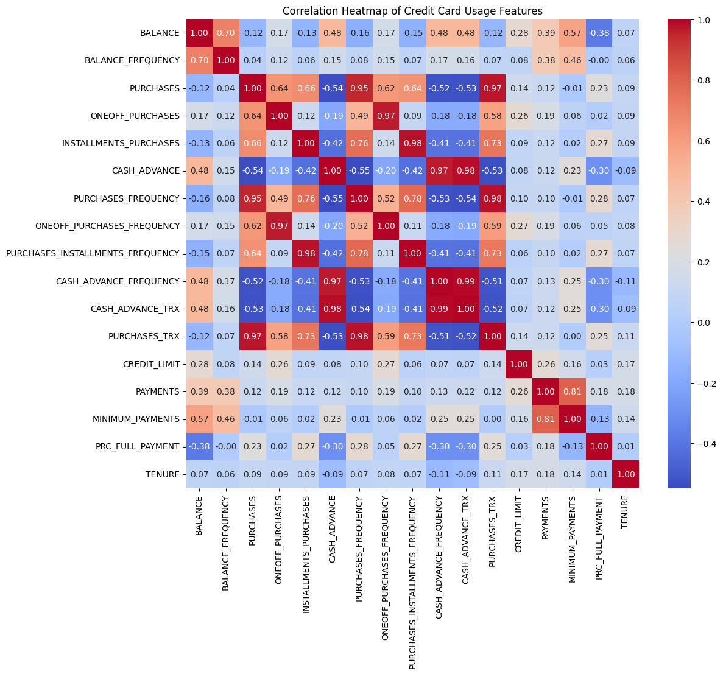
This Heatmap displays the correlation between various credit card usage features providing insights into how different behaviors and metrics relate to each other
KEY OBSERVATIONS
High Positive Correlations:
Purchases and purchases trx
Installement and Installment trx
Cash advance and cash advance trx
Oneoff purchase and purchase freq
High Negative Correlations:
PRC full payment and Balance
Cash advance PRC full payment
Moderate Correlation
Balance and balance frequency
Minimum payments and Balance
Cluster of Features
Purchase-related cluster
Cash advance cluster

Slide 9
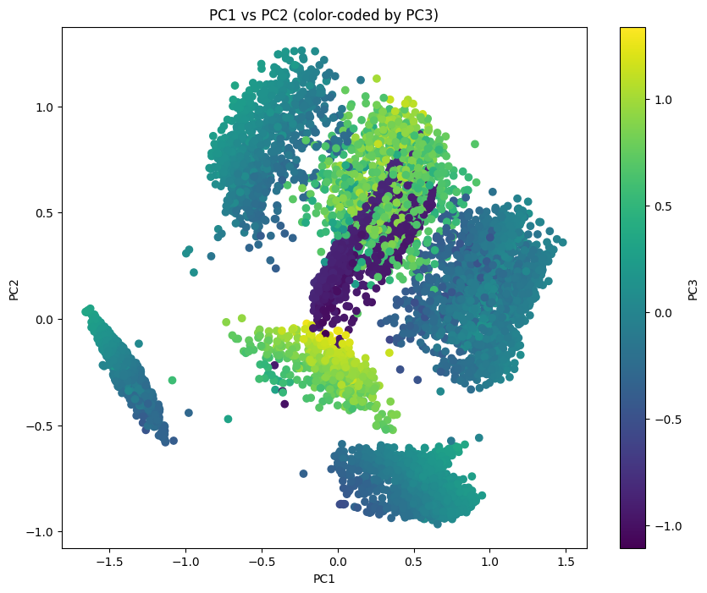
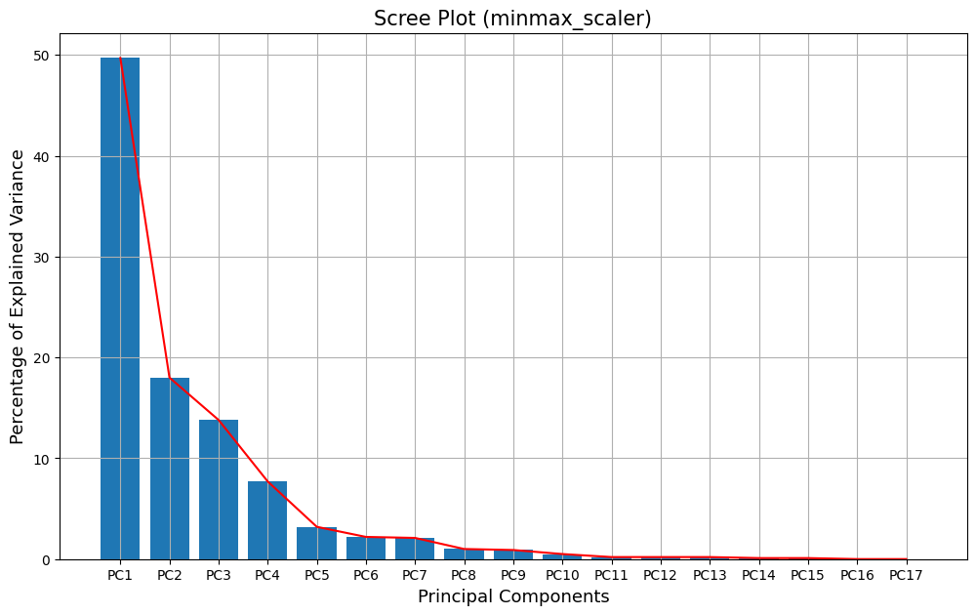
Principal Component Analysis
81.5% variance of the dataset lies on the first 3 Principal Components
Plotting the first 3 Principal Component with PC1 and PC2 and PC3 as the color to visualize depth in 2D space

Slide 10
Clustering Methods
Kmeans clustering
Efficient for larger datasets with clear spherical clusters.
Agglomerative clustering
Useful for smaller datasets or when the natural heirarchy is important
DBSCAN
Ideal if varying densities within the clusters are suspected. Though it struggles with high-dimensional data.

Slide 11
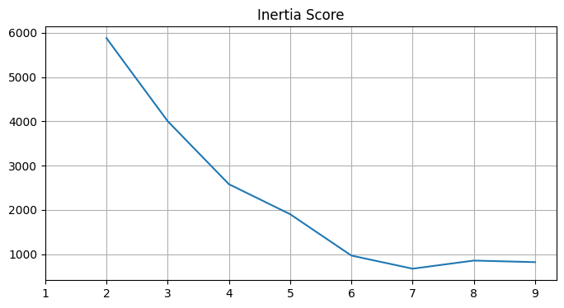
KMEANS CLUSTERING
Choosing the number of K
To determine the optimal number of Clusters, for alogarith like Kmeans use Inertia score or Elbow Method and Silhouette score.
Elbow Criterion Method: 7 clusters

Slide 12
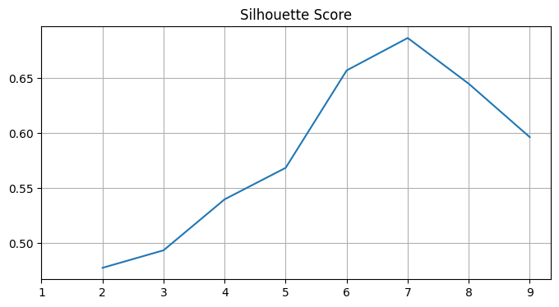
Silhouette Score
A higher Silhouette Coefficient score relates to a model with better-defined clusters.
KMEANS CLUSTERING
Silhouette Score Method: 7 clusters

Slide 13
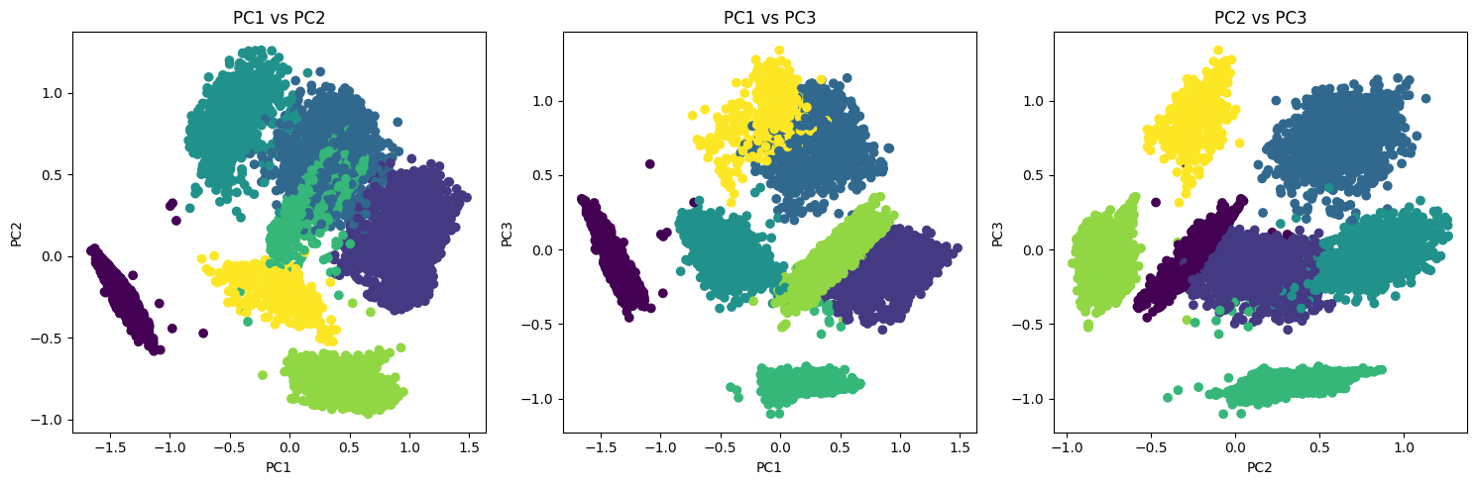
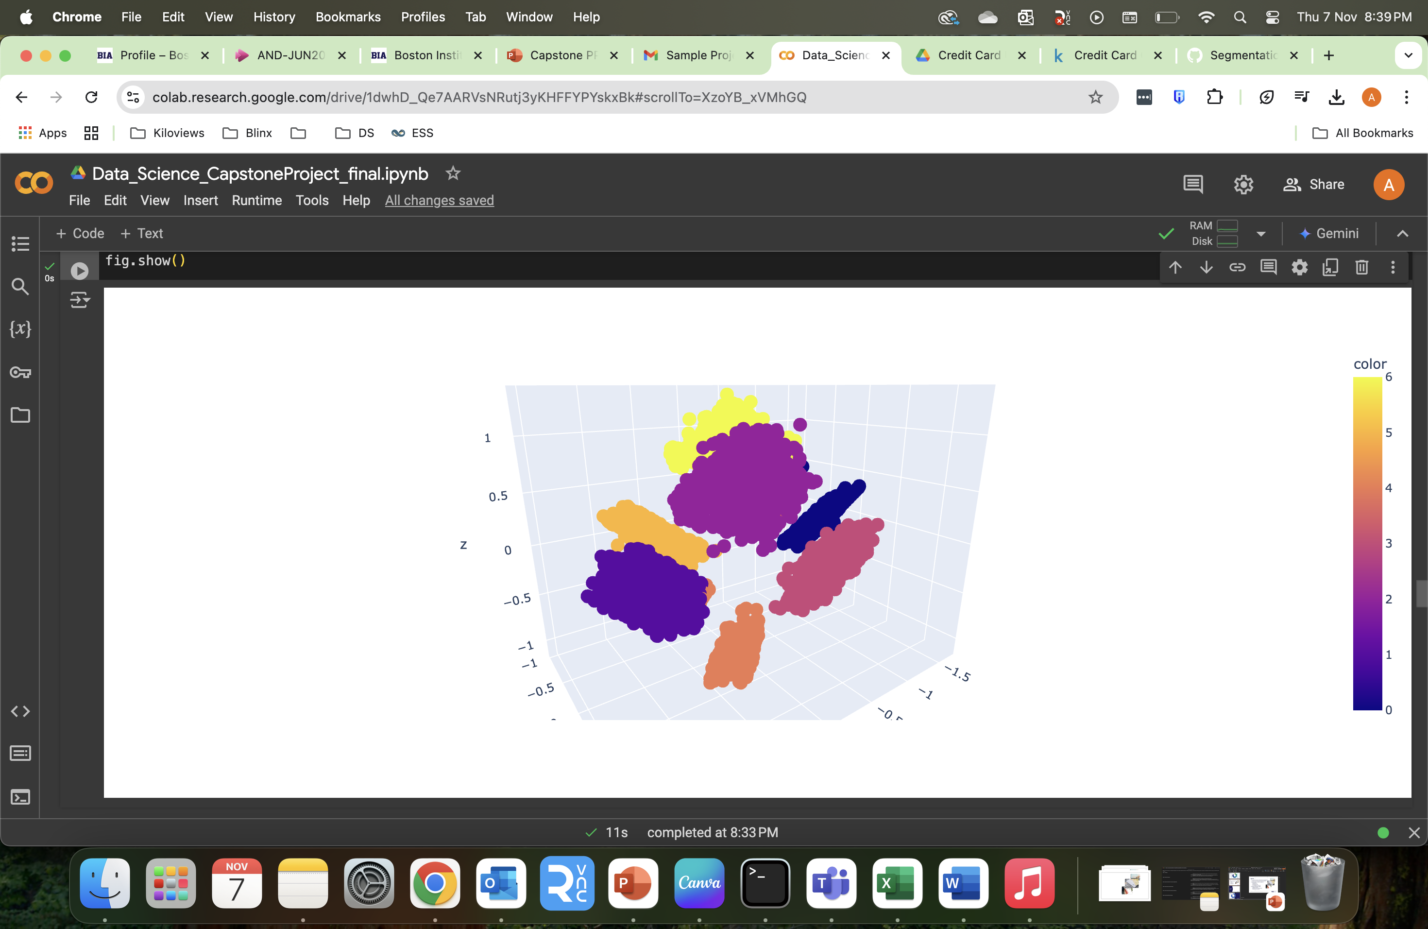
Kmeans Clustering
2D Scatter plot for Kmeans Clustering
3D scatter plot for Kmeans Clustering

Slide 14
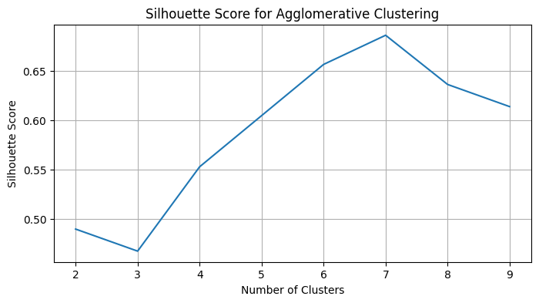
AGGLOMERATIVE CLUSTERING
Silhouette Score
A higher Silhouette Coefficient score relates to a model with better-defined clusters.
Silhouette Score Method: 7 clusters

Slide 15
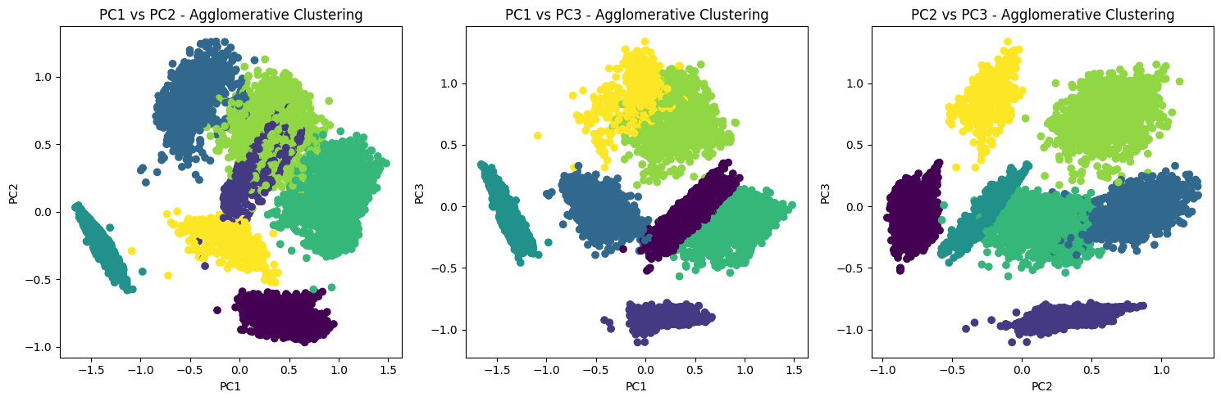
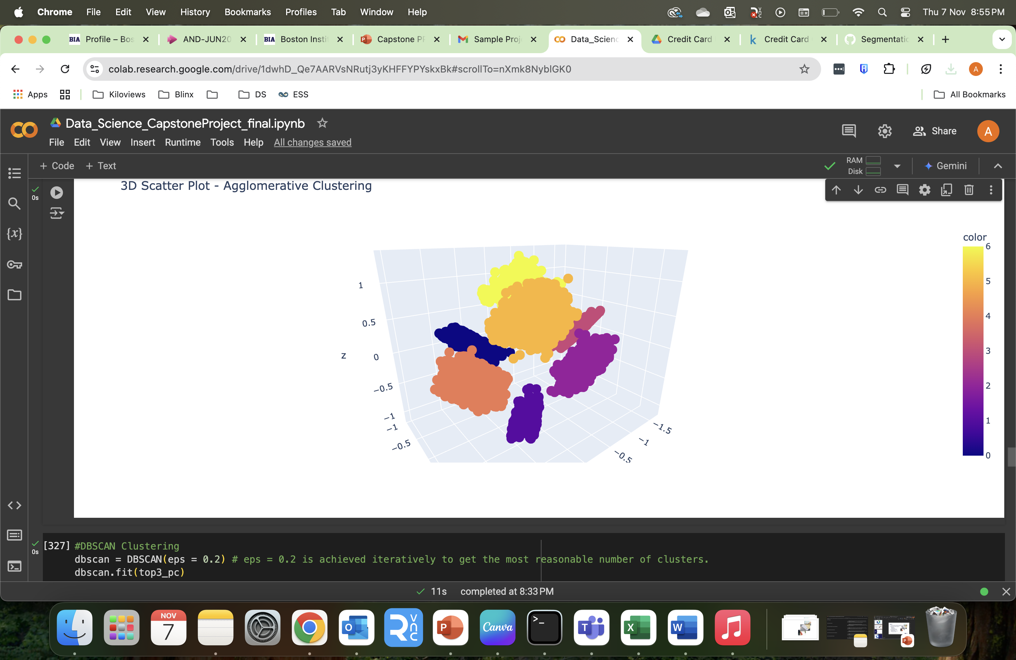
Agglomerative Clustering
2D Scatter plot for Agglomerative Clustering
3D scatter plot for Agglomerative Clustering

Slide 16
DBSCAN CLUSTERING
DBSCAN is a density-based clustering algorithm that works on the assumption that clusters are dense regions in space separated by regions of lower density. DBSCAN is used to find arbitrary shaped clusters and cluster with noise, like outliers.
Unlike Kmeans and Agglomerative clustering. DBSCAN don’t a necessary k-number or silhouette score.

Slide 17
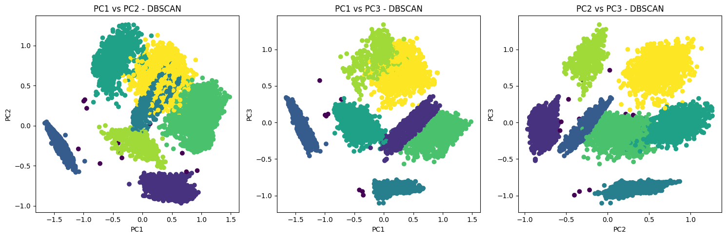
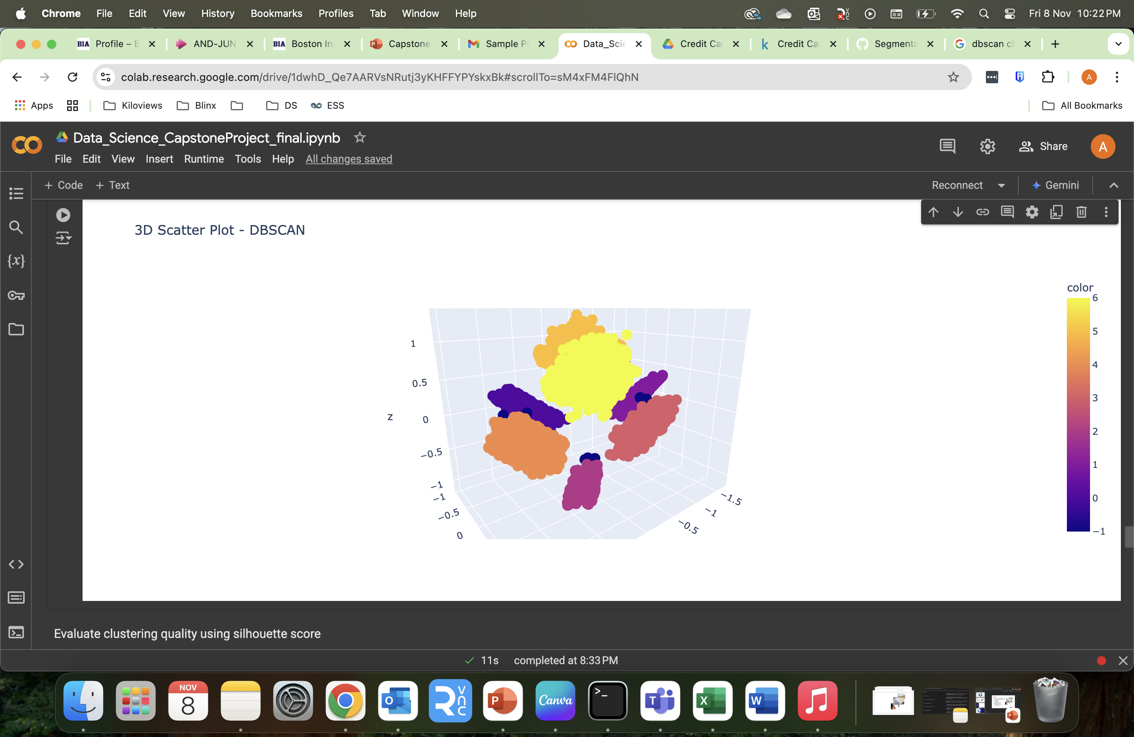
DBSCAN Clustering
2D Scatter plot for DBSCAN Clustering
3D scatter plot for DBSCAN Clustering

Slide 18
Clustering Method Comparison:
KMeans achieved the highest silhouette score of 0.6865, indicating that it provided the most well-separated clusters among the three methods.
Agglomerative Clustering scored slightly lower at 0.6858, showing that it performed comparably to KMeans but with marginally less separation between clusters.
DBSCAN had a silhouette score of 0.6834, the lowest of the three. This result suggests that DBSCAN’s clusters were somewhat less cohesive or had more overlap, possibly due to varying density in the data, which DBSCAN is sensitive to.

Slide 19
CLUSTER PROFILE
and
RECOMMENDATION

Slide 20

Dashboard

Slide 21
Cluster 0 Moderate Spenders with Stable Usage
This cluster likely represents average spenders with moderate credit use and lower dependency on cash advances, suggesting a stable and reliable customer group.
Recommendations
Loyalty Programs: Offer points-based or cashback rewards to encourage continued usage and build loyalty.
Cross-Sell Opportunities: Introduce additional financial products like personal loans or savings accounts that may appeal to moderate spenders.

Slide 22
Cluster 1 High Credit Limit & Low Usage
This group may represent inactive or conservative users with high credit limits but minimal spending. They may need engagement to increase activity or represent low-risk, low-revenue customers.
Recommendations
Re-engagement Campaign: Offer incentives like cashback on the first purchase or waiver of annual fees to encourage card usage.
Usage-Based Promotions: Create targeted campaigns to incentivize specific spending categories, such as travel or dining, which may appeal to more conservative or inactive users.

Slide 23
Cluster 2 Low Income / Newer Users with Low Balances and Credit Limits
This cluster likely represents new or low-income users who have lower balances and credit limits. They may benefit from incentives to increase engagement or credit limits.
Recommendations
Introductory Offers: Provide promotions, like introductory 0% interest on purchases, to help these newer customers get accustomed to using their credit cards.
Gradual Credit Limit Increases: Based on payment history, consider offering small, incremental credit limit increases to build customer trust and engagement.

Slide 24
Cluster 3 High-Spending & Cash Advance Dependency
This cluster likely represents high-value, high-spending customers with high credit limits. However, their frequent use of cash advances could indicate liquidity needs, and they may need monitoring for credit risk or engagement for premium services.
Recommendations
Premium Credit Card Options: Offer upgrades to premium cards with additional perks like travel rewards, concierge services, or access to exclusive events to deepen engagement.

Slide 25
Cluster 4 Mid-Tier Stable Spenders with Low Cash Advance Dependency
This cluster could represent middle-income customers with stable spending patterns and little need for cash advances. They may be prime candidates for targeted offers to increase loyalty.
Recommendations
Upgrade Incentives: Encourage these stable users to upgrade to a higher-tier card by offering benefits like rewards points, annual fee waivers, or travel-related perks.
Increase Engagement: Target them with campaigns for higher spend categories, like travel or luxury, or incentivize certain types of purchases (e.g., dining, entertainment) to increase card usage.

Slide 26
Cluster 5 Long-Term, Low-Spending Customers with Low Balances
This cluster represents low-engagement, low-risk customers who do not spend much or use their credit cards actively. They may benefit from reactivation campaigns or low-cost service offers to boost engagement.
Recommendations
Retention Strategies: Offer them fee waivers or basic loyalty points to keep them engaged and prevent attrition, as they are likely low-risk but also low-revenue customers.
Simple Upgrade Offers: Provide low-cost upgrade options that give modest rewards, appealing to conservative spenders.

Slide 27
Cluster 6 High-Value, High-Spending Customers with Frequent Cash Advances
This cluster represents a high-value segment with very high spending and credit use, including frequent cash advances. They are prime candidates for premium services and loyalty rewards but may need careful monitoring due to high credit usage.
Recommendations
Exclusive Benefits: Offer highly personalized rewards and services, like concierge services, airport lounge access, or exclusive event invitations. Consider assigning a dedicated relationship manager.
Financial Management Services: Given the frequent use of cash advances, they may benefit from specialized financial management services. Offer advisory services or access to personal loans as an alternative to cash advances.

Slide 28
Questions?

Slide 29
Thank You!

